Slide 1
Theory of Automata
Nasreen Akhtar

Slide 2
Contents
Outline
Objectives
Background
Motivation & Description
Nasreen Akhtar - Theory of Automata

Slide 3
Course Outline
Finite State Models
Language definitions preliminaries
Regular expressions/Regular languages
Finite automata (FAs)
Transition graphs (TGs)
NFAs, kleene’s theorem
Making a Scanner
Transducers (automata with output)
Pumping lemma and non regular language
Grammars and PDA
Context free grammars
Derivations, derivation trees and ambiguity
Operations preserving CFLs
Normal form grammars and parsing
Push Down Automata
Making a Parser
Pumping lemma and non-context free languages
Decidability
Chomsky’s hierarchy of grammars
Turning Machines Theory
Turing machines
Post machine
Turing Machine project
Variations on TM
TM encoding, Universal Turing Machine
Context sensitive Grammars
Defining Computers by TMs
Nasreen Akhtar - Theory of Automata

Slide 4
Objectives
The course aims to develop an appreciation of theoretical foundations of computer science through study of mathematical & abstract models of computers and theory of formal languages
Nasreen Akhtar - Theory of Automata

Slide 5
Background
We shall study several mathematical models that will describe with varying degrees of accuracy parts of computers, types of computers, and similar machines.
In particular, the way we shall be studying about computers is to build mathematical models, called machines, and then to study their limitations by analyzing the types of inputs on which they can operate successfully.
The collection of these successful inputs is called the language of the machine.
Nasreen Akhtar - Theory of Automata

Slide 6
Every time we introduce a new machine, we will learn its language; and every time we develop a new language, we will try to find a machine that corresponds to it. (Language vis-à-vis Machine)
This interplay between languages and machines will be our way of investigating problems and their potential solutions by automatic procedures, which we call algorithms.
We will study different types of theoretical machines that are mathematical models for actual physical processes. By considering the possible inputs on which these machines can work, we can analyze their various strengths and weaknesses.
Nasreen Akhtar - Theory of Automata

Slide 7
What is mathematical about the models?
We are obliged to prove the truth about whatever we discover.
So consider only question of whether certain tasks can be done at all. Conclusion are of the form “this can be done” or “this can never be done”.
When we reach conclusions of the second type, we mean not just that techniques for performing these tasks are unknown at the present time, but that such techniques will never exist in the future.
Nasreen Akhtar - Theory of Automata

Slide 8
We will arrive at what we may believe to be the most powerful machine possible. When we do, we will be surprised to find tasks that even such machine cannot perform.
Our ultimate result is that no matter what machine we build, there will always be questions that are simple to state and that the machine can not answer.
Limitation of a machine / algorithm / mathematical model / computer
  Vision/hear/smell/touch - emotions/intuition
Nasreen Akhtar - Theory of Automata

Slide 9
Theory of automata?
It is the plural of automaton, and it means “something that works automatically”
What is a Computer?
What is an Abstract Model of a Computer?
What was before Computers?
Search for Algorithms for solving a math problems; What it means?
Which Statement has proof and how can we generate these proofs?
Nasreen Akhtar - Theory of Automata
Notes:
An abstract machine, also called an abstract computer, is a theoretical model of a computer hardware or software system used in automata theory. Abstraction of computing processes is used in both the computer science and computerengineering disciplines and usually assumes a discrete time paradigm.

Slide 10
What does automata mean?
Automata Theory is an exciting, theoretical branch of computer science.
It established its roots during the 20th Century, as mathematicians began developing - both theoretically and literally - machines which imitated certain features of man, completing calculations more quickly and reliably.
Nasreen Akhtar - Theory of Automata
Notes:
An abstract machine, also called an abstract computer, is a theoretical model of a computer hardware or software system used in automata theory. Abstraction of computing processes is used in both the computer science and computerengineering disciplines and usually assumes a discrete time paradigm.

Slide 11
People & Problem
Alonzo Church,
Stephen Kleene,
Emil Post,
Jhon Van Neuman and
Alan Turing
Noam Chomsky
An extraordinary simple set of building blocks from which all mathematical algorithms can be comprised.
They Fashioned (various versions) of a Universal Algorithm Machine; Universal Model for all algorithms
Nasreen Akhtar - Theory of Automata

Slide 12
Study of Languages language vs computational model
In independent work in Mathematical Logic, it was noted that
  There is a natural correspondence between study of models of Computation and
  The study of natural language Linguistics in an abstract and mathematical sense.
  Noam Chomsky created the subject of mathematical model for description of languages
  His study grew to the point where it began to shed light on the study of computer languages
Nasreen Akhtar - Theory of Automata

Slide 13
The theory of Formal Languages
Regular Languages RE / FSM
Context free languages CFG / PDA
Context Sensitive Languages L Bounded TM
Recursively enumerable Languages TM
Alan Turing’s theoretical model for an algorithm machine employing very simple set of mathematical structure held out the possibility that a physical model of the turnings idea could be actually build.
1st computer was built and Turing was part of it in Manchester University.
Nasreen Akhtar - Theory of Automata

Slide 14
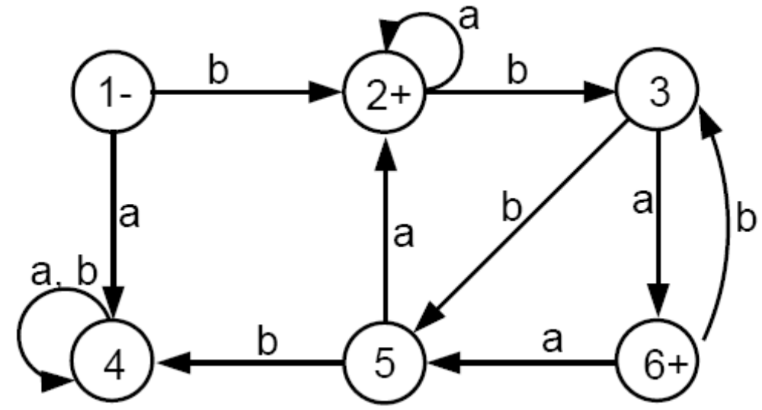
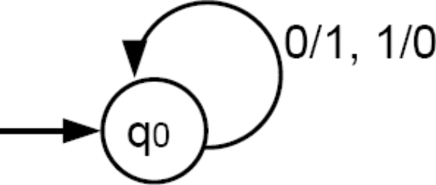
Sample Work
Nasreen Akhtar - Theory of Automata

Slide 15
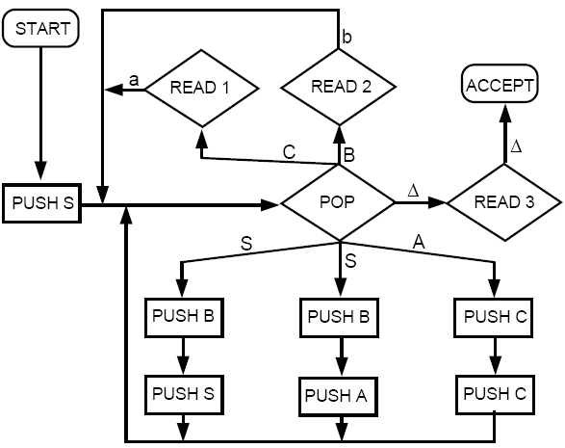
Nasreen Akhtar - Theory of Automata

Slide 16
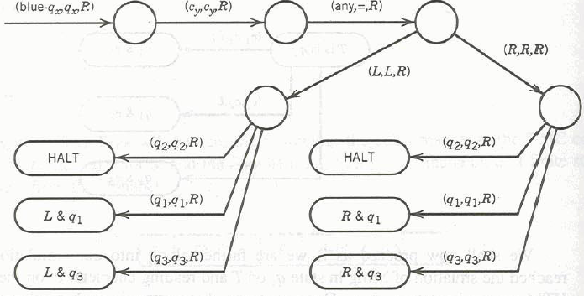
Nasreen Akhtar - Theory of Automata

Slide 17
S → SB | AB
  A → CC
  B → b
  C → a
S → AB | λ
  A → AB | CB | a
  B → AB | b
  C → AC | c
Nasreen Akhtar - Theory of Automata

Slide 18
Practical Applications
FA:
  Text processing, compilers and hardware design
CFGs:
  Programming languages and AI
Cellular Automata:
  Biology
Digital Physics:
  Whole universe is computed by some sort of a discrete automaton
Nasreen Akhtar - Theory of Automata

